Slide 1
Deep Residual Networks
su
2018/1116

Slide 2
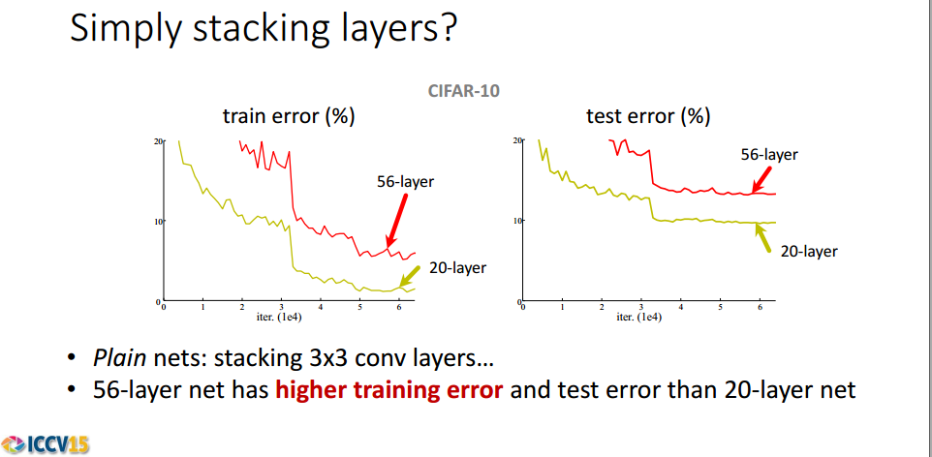
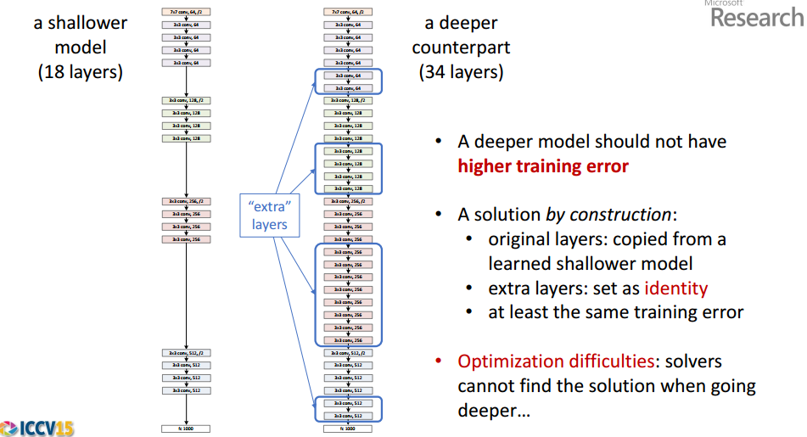
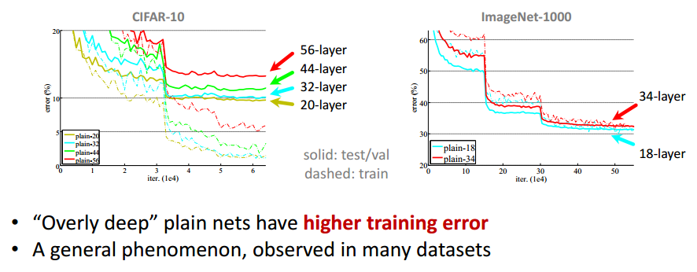
Simply stacking layers?

Slide 3
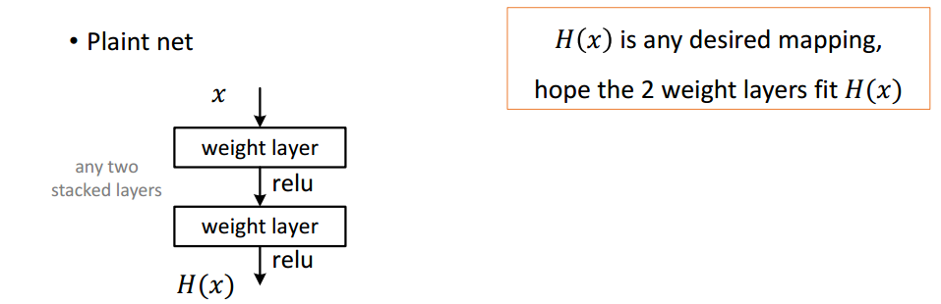
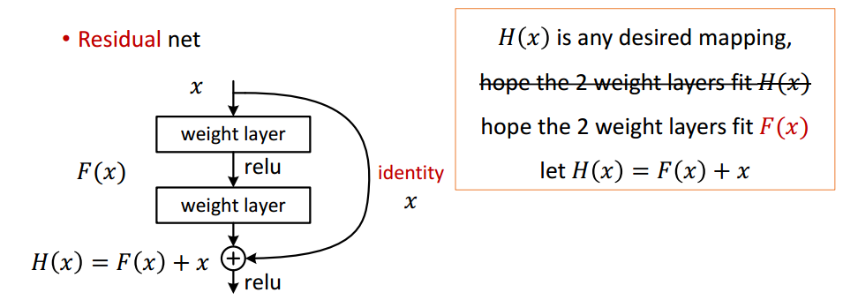
Deep Residual Learning

Slide 4
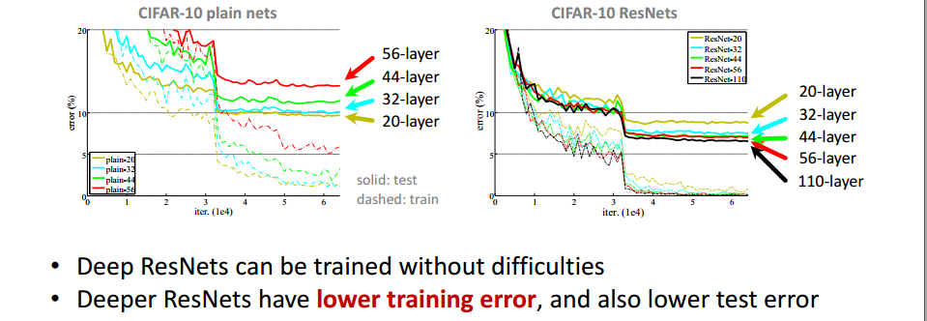
Result on CIFAR-10

Slide 5
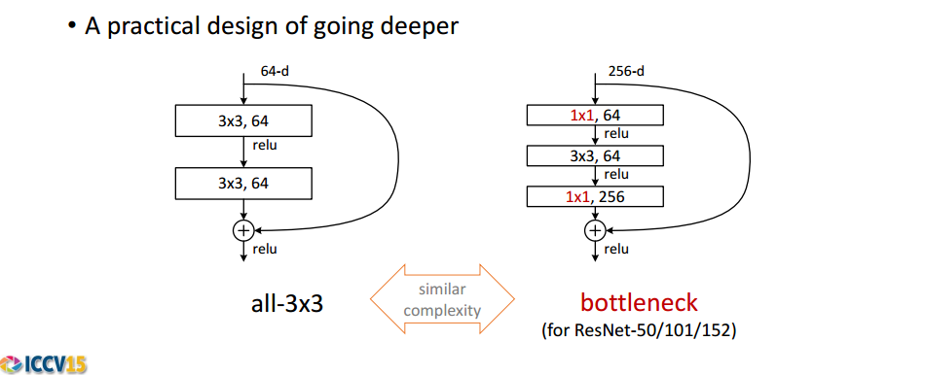
ImageNet experiments

Slide 6
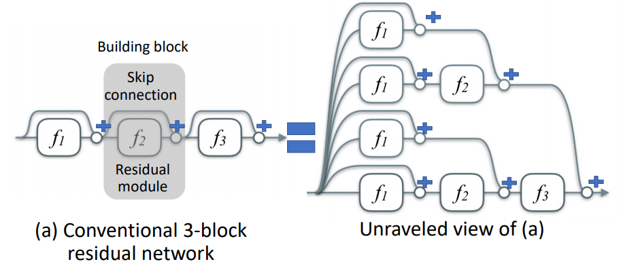
Why does this work?

Slide 7
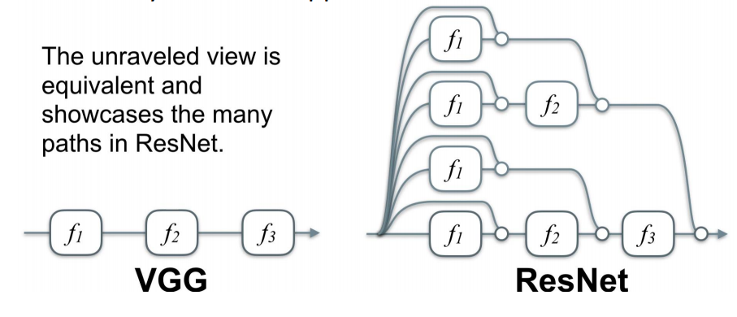
Why does this work?

Slide 8
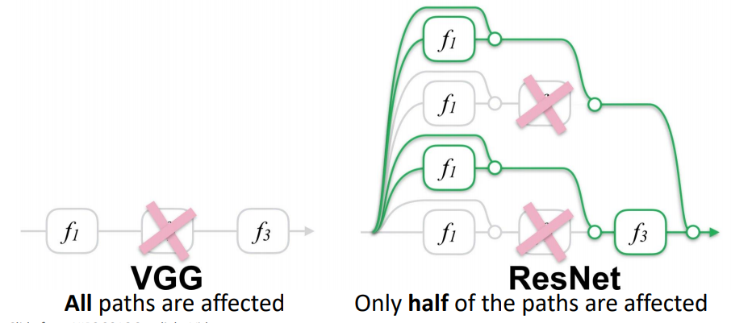
Deletion of one layer at test time

Slide 9
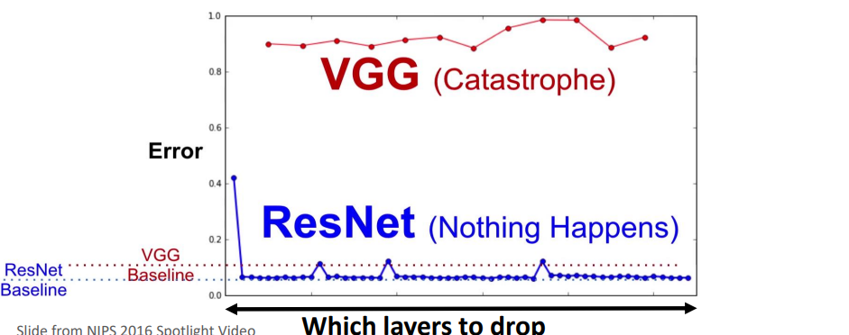
Deletion of one layer at test time

Slide 10
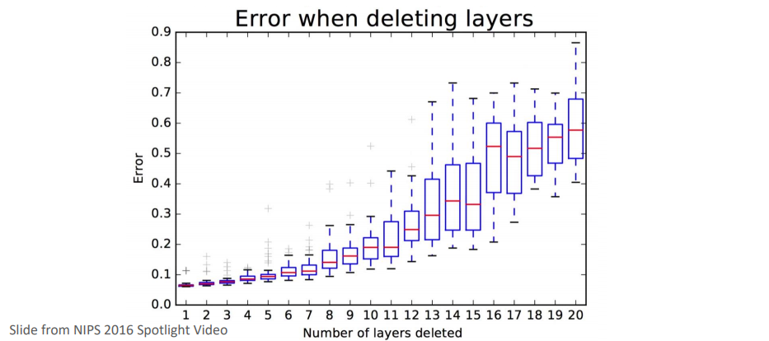
Deletion of several layers

Slide 11
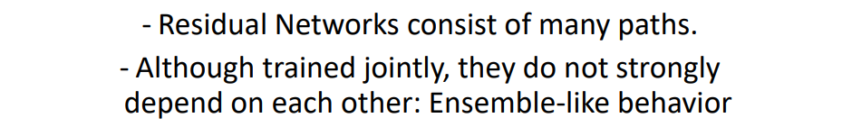
Conclusion 1

Slide 12
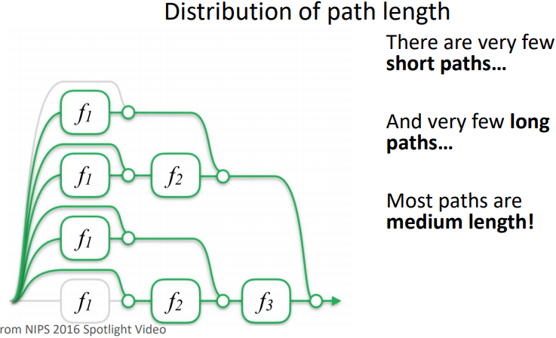
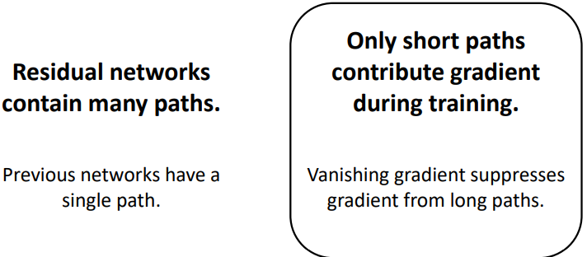
Path Length

Slide 13
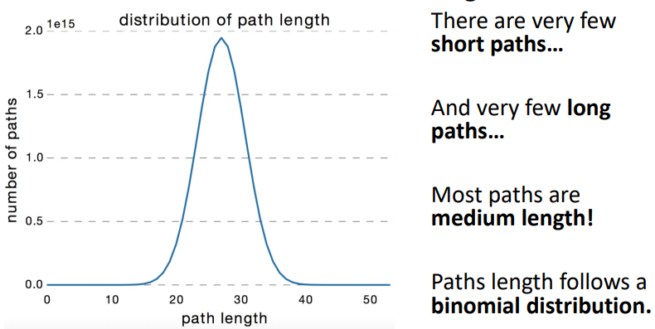
Distribution of path lenth

Slide 14
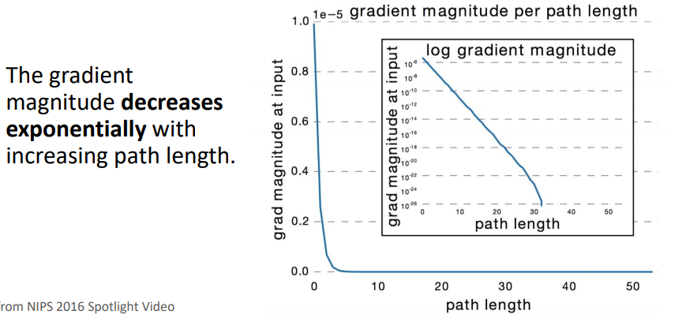
Vanishing gradient

Slide 15
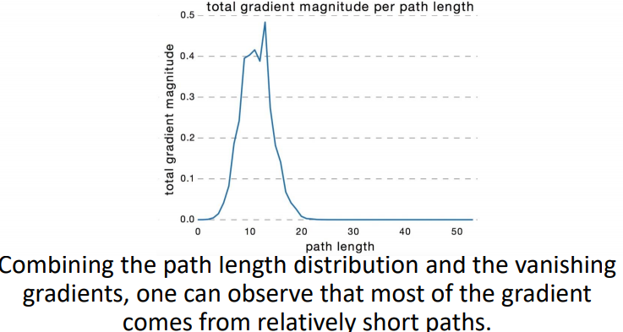
Gradient during training with path length

Slide 16
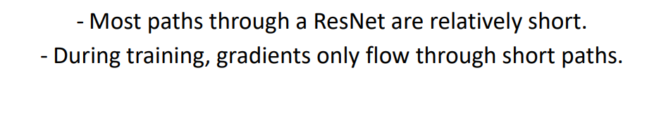
Conclusion 2

Slide 17
Reference:
- Residual Networks Behave Like Ensembles of Relatively Shallow Networks
- Deep Residual Learning for Image Recognition

